Slide 1

A New Value Proposition for the AMA

Slide 2
Proposal
Implement a value-driven measurement system for healthcare to expand the membership, relevancy, and revenue potential for the AMA.
To provide a unified vision for delivering sustainable value for patients, practitioners, and provider.
To drive innovation & collaboration.
To guide continuous improvement (quality and efficiency) across the continuum of care.

Slide 3



The Vision
Value
Quality
Practitioner-Driven
Results
Provider-Driven
Patient-Driven
“We continue to pay for lots of medical procedures that don't add to health value and in fact just add costs to the system..”
- Kathleen Sebelius

Slide 4


Drive LEAN with Value-Driven Measurement
Specify value in the eyes of the customer.
Identify the value stream and eliminate waste.
Make value flow at the pull of the customer.
Involve and Empower employees.
Continuously improve in the pursuit of perfection.

Slide 5
Current Challenges
Eroding member base.
Aging membership.
Decline in revenues from membership.
Not perceived as an innovation leader.
Value across the continuum of care is not measured from a patient (customer) perspective.
Healthcare is fractionalized and becoming more distributed.
The government is trying to lead healthcare reform.
Need for clear leadership to drive reform, innovation, and unification across the healthcare continuum.
“Cost containment doesn't mean a lot unless we also have a corollary of increasing quality.”
- Kathleen Sebelius

Slide 6
AMA’s Role in Healthcare Reform
A relevant voice that should be heard by the government.
Provide healthcare stakeholders with the following answers:
Practitioners are worried about quality, timeliness, and effort of care
Patients are worried about quality of care, loss of control, and cost
Providers are worried about loss of control and revenue
Opportunity for unifying leadership to provide guidance and direction for change (much of which will be disruptive).
Opportunity to encourage collaboration and cooperation to solve the healthcare needs in the US and across the world.
Opportunity to create a “system” of healthcare guided by consistent value-driven metrics (outcomes).

Slide 7
Needs of the Patients
To have affordable healthcare.
To have attainable healthcare.
To have more accessible healthcare.
To have consistent levels of quality (results).
To receive a total healthcare experience:
Ensure their functional outcomes met.
Ensure their emotional outcomes met.
Ensure their outcomes are met across the continuum of care (beyond the hospital, into clinics, and into the home).
“We continue to pay for lots of medical procedures that don't add to health value and in fact just add costs to the system..”
- Kathleen Sebelius

Slide 8
Needs of the Practitioners
To improve diagnostic capabilities in a cost-effective manner.
To improve clinical processes.
To provide consistent levels of quality.
To move beyond service, where they can deliver a positive experience.
To be able to reliably measure value for their patients, for themselves as individual practitioners , and for their practices.

Slide 9
Needs of the Providers
To get pharmaceutical and device manufacturers, insurers, and healthcare suppliers to become aligned, unified and collaboratively focused on a consistent set of outcomes.
To increase collaboration NOT competition.
To understand how to identify, measure and deliver value throughout the healthcare value network.
To move towards a shared revenue model where everyone can still win, but not at the expense of others (esp. the patients & the public).

Slide 10
AMA at the forefront of Healthcare
Defining & delivering the prescription for healthcare reform should come from within healthcare (not the government).
Creating a vision for a new healthcare system by forming a collaborative model with healthcare advocacy organizations, institutions, providers and practitioners.
Providing the practitioners with a consistent set of benchmarks for measuring the value they deliver to patients.
Driving open innovation among providers to create a more efficient process for guiding and creating value.
Working collaboratively with the government to guide more efficient and effective funding that drives healthcare reform.

Slide 11
Moving from Assumptions to Implementation
Establish a program focused on mapping the Jobs & Outcomes across the healthcare domain.
Build a portfolio of unmet needs (opportunities) for improving value delivery to patients and practitioners.
Establish a prioritization model to direct resources in an efficient manner.
Create an open innovation framework using the opportunities to generate ideas that can address the most important (prioritized) unmet needs.
Establish a shared revenue model as part of a collaborative to address unmet needs.

Slide 12
Measuring Value for Healthcare
Build a portfolio of jobs & outcomes:
For measuring value *
For driving innovation
For directing efforts to improve quality
For guiding initiatives to reduce cost
* Value is created between the Patient & Practitioner

Slide 13
Enabling Value for Healthcare
Value-Driven Healthcare Platform
Technology
Ideas
Resources
Innovation
Value Measurement
New Concepts
New Products & Services
New Value Delivery
Outcomes
Compliance
Quality & Efficiency
Value-Driven metrics are used to drive innovation & direct Quality & Efficiency

Slide 14
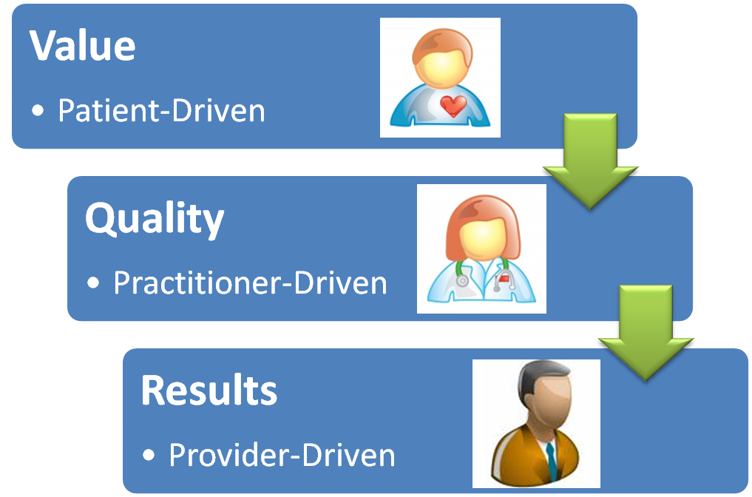
An Expanded Membership Model
Providing Patients with a way to measure the value they should be receiving for healthcare throughout the continuum
Guiding Practitioners to measure and optimize the value they deliver to Patients
Guiding the Providers to deliver value to Patients & Practitioners
AMA

Slide 15
Reducing Costs & Driving Value
Today…
We rely on a variety of measures to deliver value across an increasingly distributed network of healthcare participants (providers, practitioners)
Tomorrow…
We will use patient-driven measures of value to:
Unify the delivery of value to the patient across the continuum of healthcare
Ensure continuous improvement efforts focused on quality and results (efficiency and costs) align with value-driven metrics
Guide providers to build the right products & services for patients and practitioners

Slide 16

Positioning the AMA to Lead Healthcare Reform
Value Measurement Repository
Healthcare
Advocacy
Groups
Healthcare
Disciplines
Providers
(Products & Services)
Institutions
Government Bodies
Advocacy Body for:
Value enablement
Value capture & measurement
Collaboration
Unification & cooperation
Reform & Sustainable Innovation
Enabling Value
Driving Innovation

Slide 17
Thank You
Prepared by
Jeffrey Wallk (Managing Partner)
Helene Sigman (Strategic Partner)

